Slide 1

Measure the distort of the wave through AD/DA converter
G02,張家菖,林宜廷

Slide 2
Content
Purpose
Structure
Result
improve

Slide 3
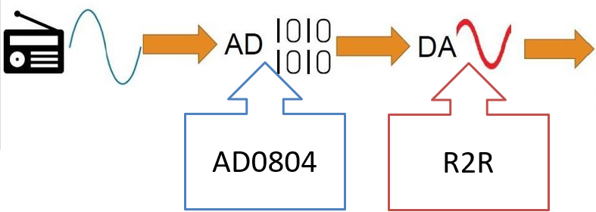
Purpose
Goal: To understand the distortion of a wave through AD and DA converter.
Process:

Slide 4
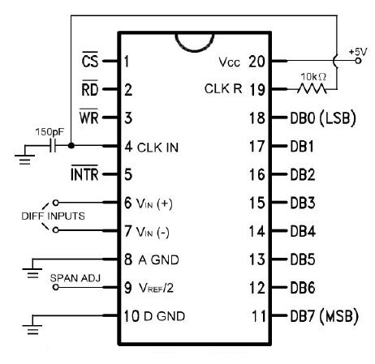
AD0804
0
3: LOW→HIGH
Open 6, 7
5: LOW (3)
Open 11~18
5: HIGH (3)

Slide 5
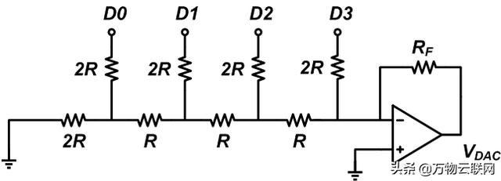

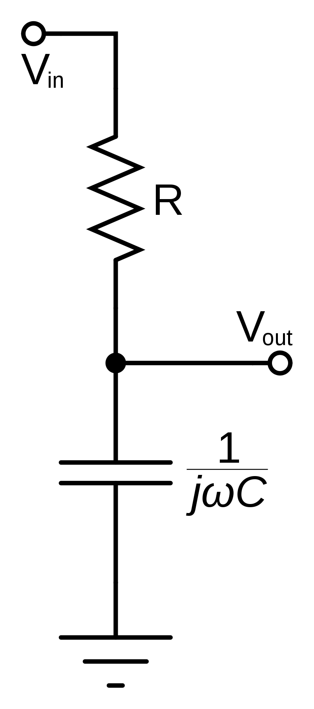
ua741

Slide 6
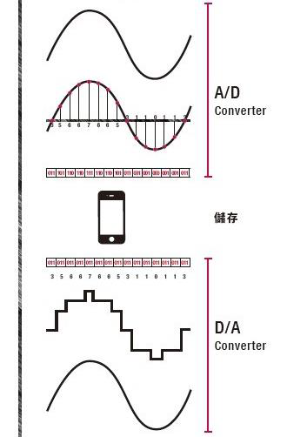
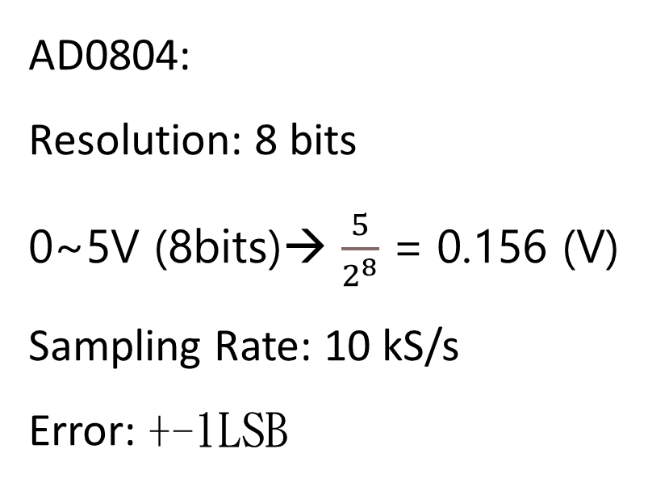
AD0804:
Resolution: 8 bits
0~5V (8bits)→ $\frac{5}{2^{8}}$ = 0.156 (V)
Sampling Rate: 10 kS/s
Error: +-1LSB

Slide 7
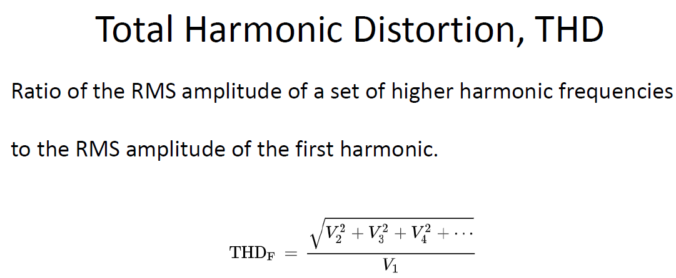
FFT → components → THD

Slide 8
Result (Frequency)

Slide 9
THD

Slide 10
Result (waveform)
Close cut-off frequency →
* sin more accurate, square more bending

Slide 11
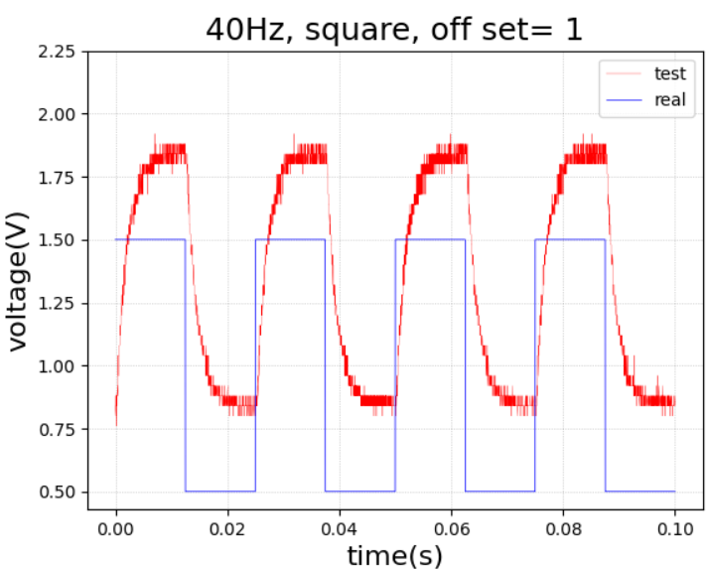

Slide 12
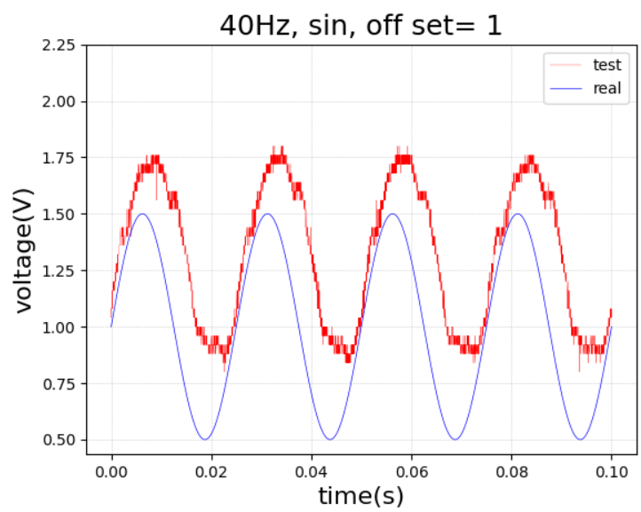

Slide 13
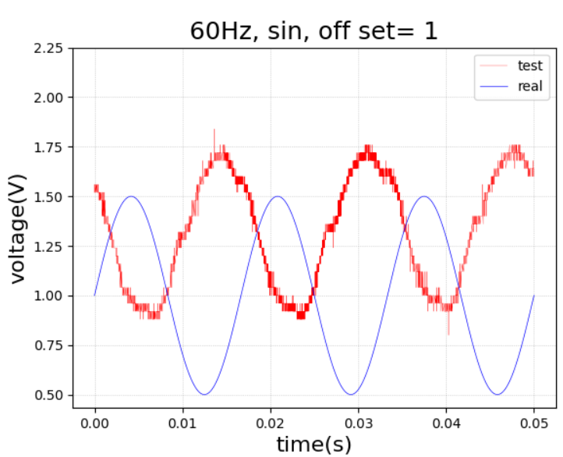

Slide 14
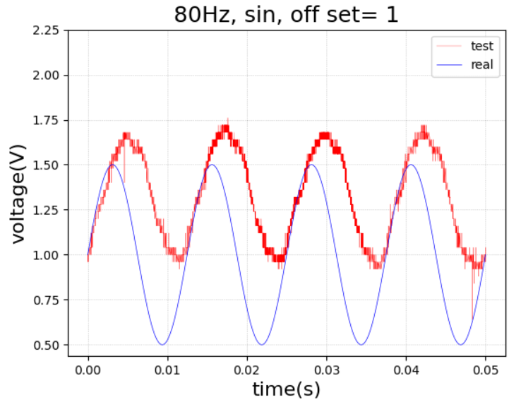

Slide 15
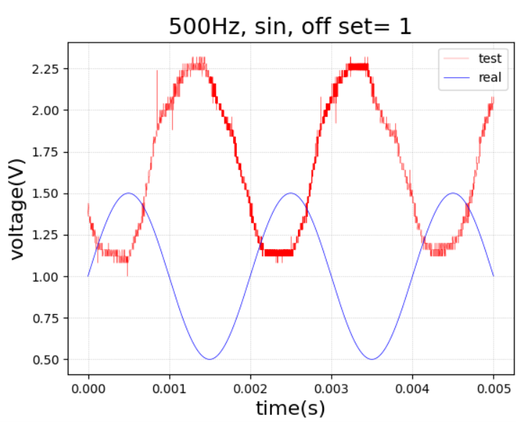

Slide 16
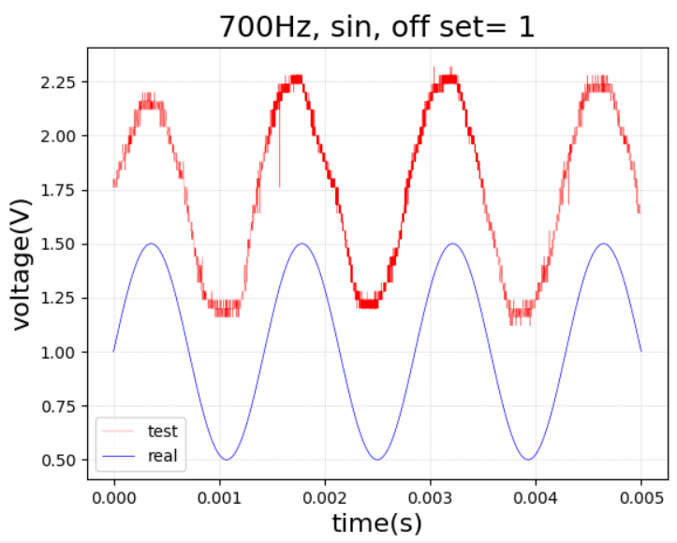

Slide 17
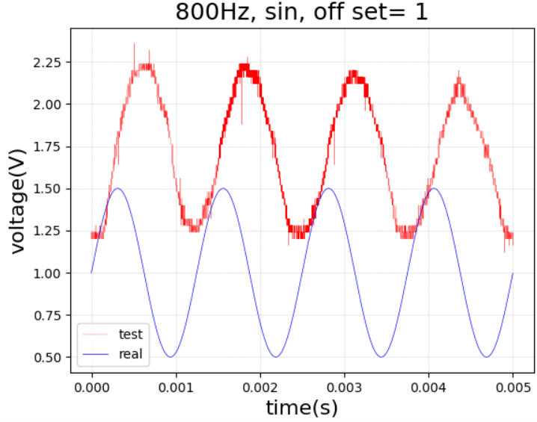

Slide 18
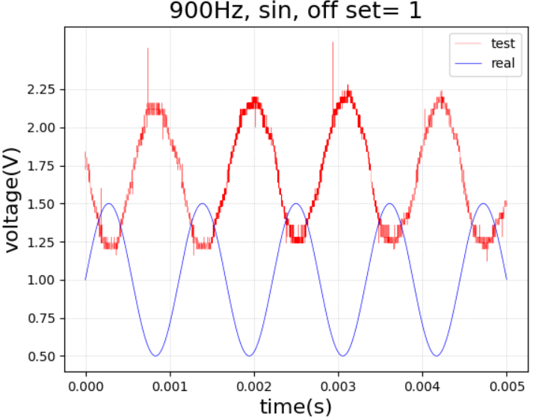

Slide 19
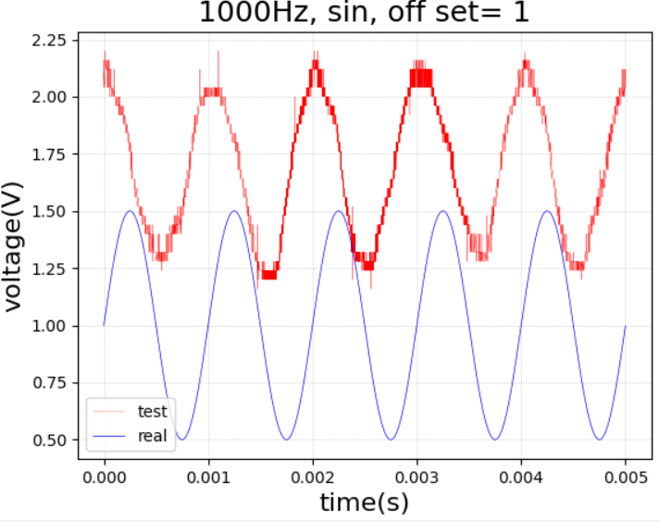

Slide 20
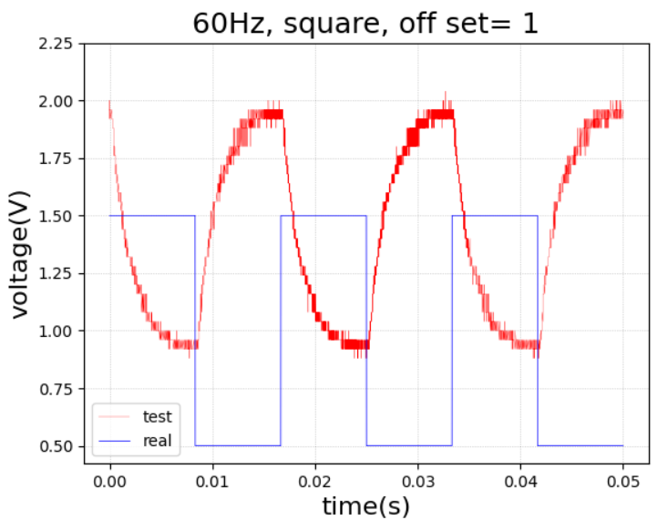

Slide 21
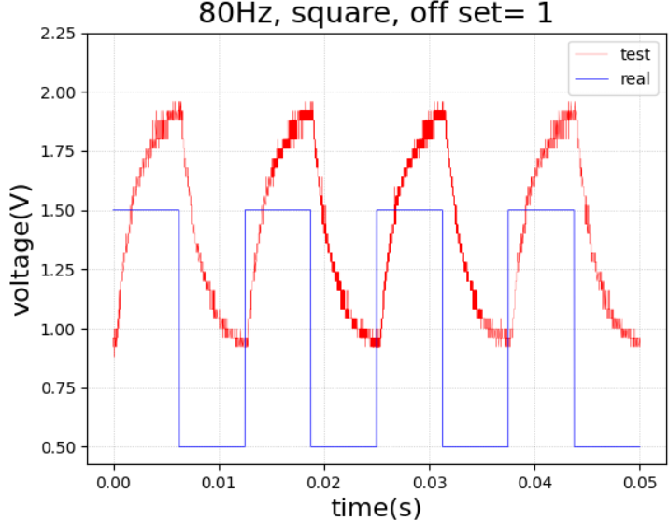

Slide 22
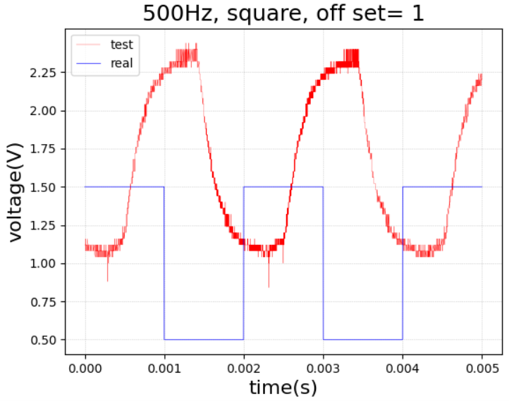

Slide 23
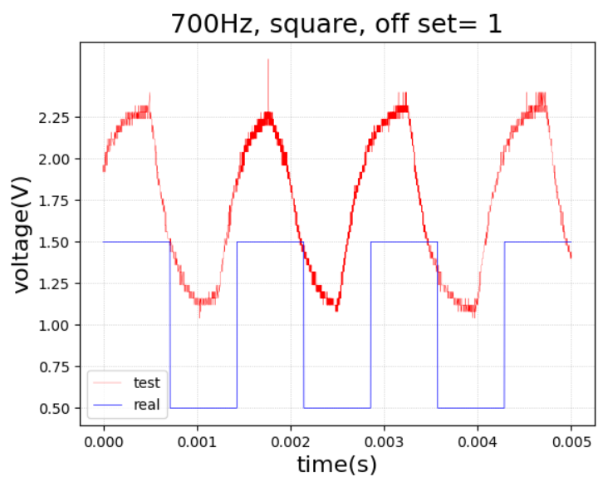

Slide 24
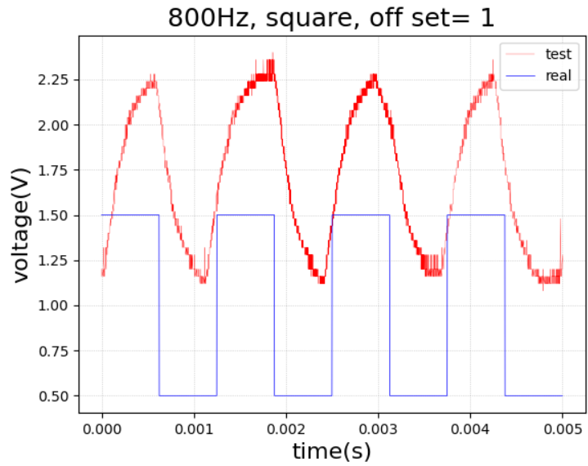

Slide 25
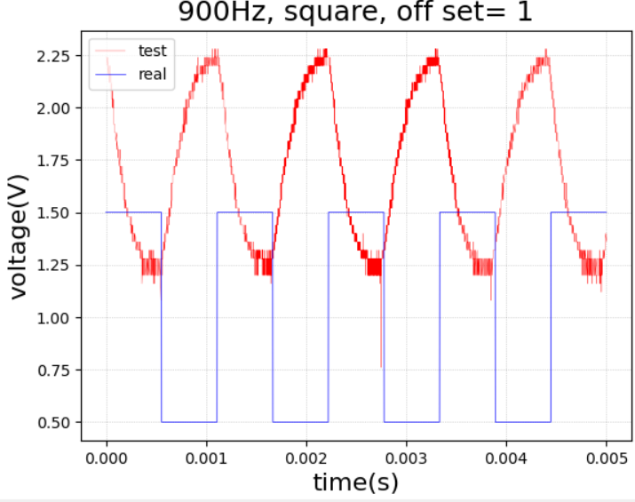

Slide 26
